Slide 1

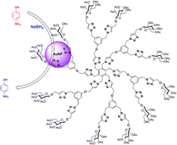
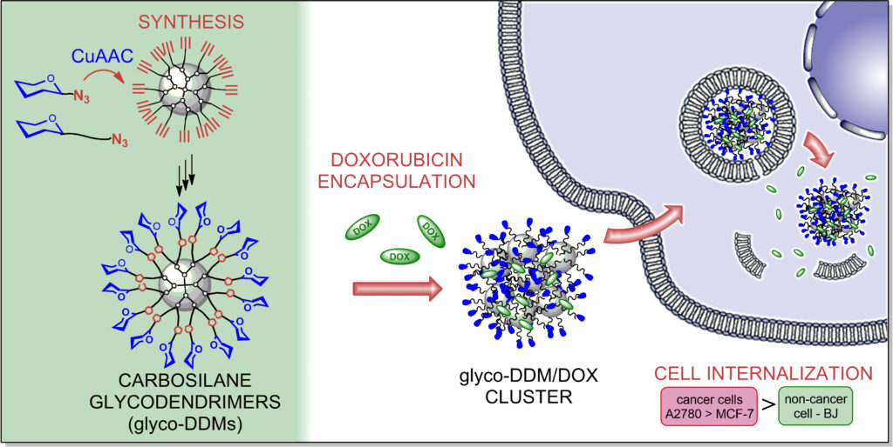

WP number/activity number: Title of the activity
A. Hujer, B. Hujerová…, F. Hujer (postdoc), ...Z. Hujer (PhD student); collaboration with WPx (if relevant)
Research Summary (03-12/2024):
Achieved research objectives, milestones……briefly summarize (in bullet points) the research activities, objectives and results and highlight the 2-3 most significant outcomes (including papers; patents, select one paper for a more detailed description on the following slides)
………..
………..
Synthesis of compounds xxx (Hujer et al. J Med. Chem)… DOI: https://doi.org/10.1021/acs.biomac.1c01264 .
We have developed…..
Analysis of xxx (Hujerová et al. Anal. Chem.),… DOI: https://doi.org/10.1021/acs.biomac.1c01264.
We analysed the structure-activity relationships….
PCT Synthesis of compounds xxx
Outputs: 5 articles (4 in Q1 journals, 2 with international co-authors, 1 in collaboration with the non-academic sector), 1 reviews in Q1 journals, 1 PCT, 1 HORIZON grant supported for funding, 1 GAČR grant submitted
Other: Equipment (if relevant; brief description of what it can do, how it is useful to other members of the project (specialized instruments can be described in detail on the next slide)
DOI: https://doi.org/10.1021/acs.biomac.1c01264

Slide 2

The project New Technologies for Translational Research in Pharmaceutical Sciences /NETPHARM, project ID CZ.02.01.01/00/22_008/0004607, is co-funded by the European Union.
Thank you for your attention.

